Slide 1

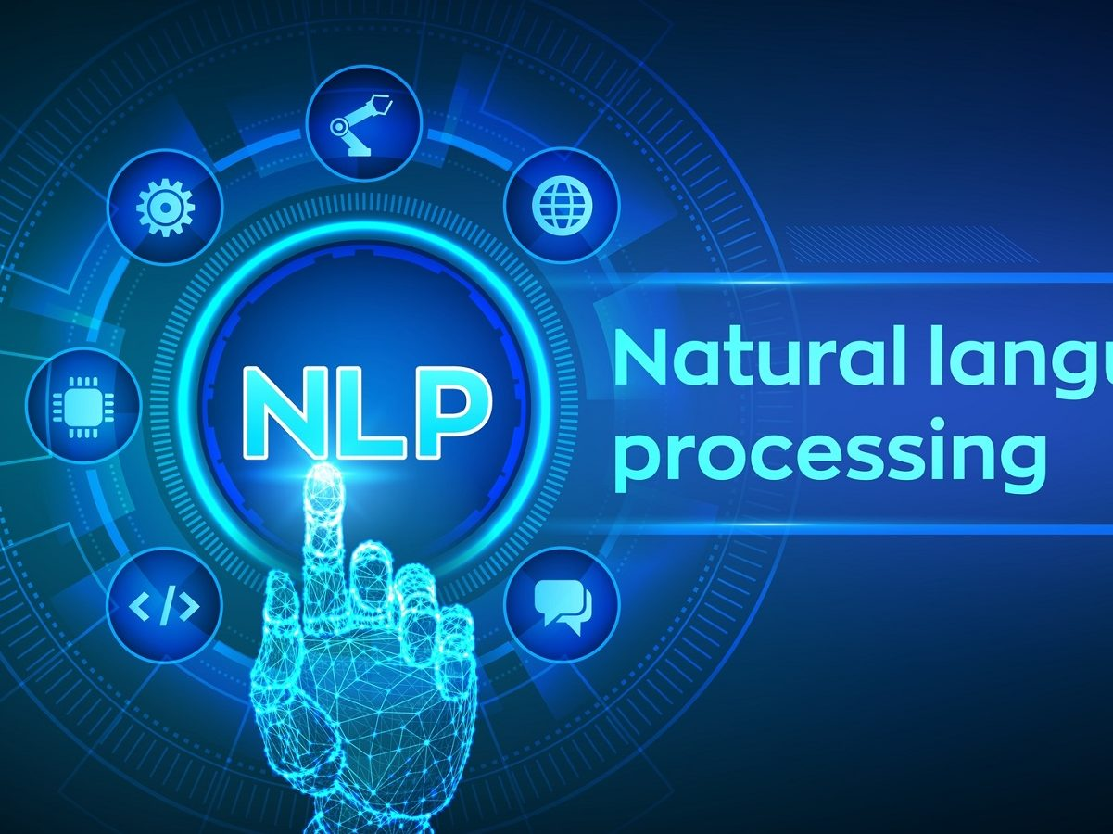
NLP for sentiment analysis based trading
Himanish
Kian
Queen’s Tower Capital, Systematic Fund
https://utilityanalytics.com/2020/07/natural-language-processing-talking-in-a-way-machines-can-understand/

Slide 2
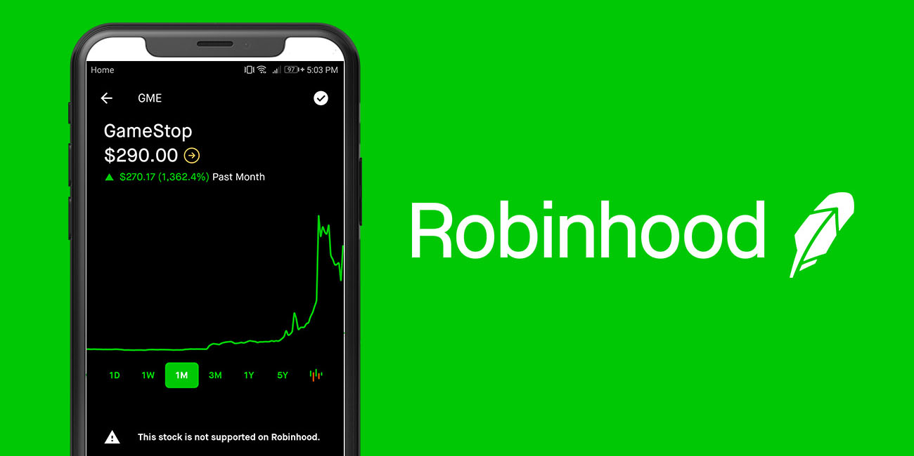

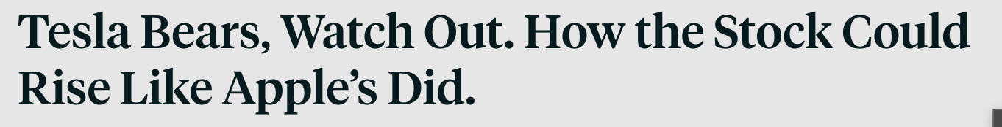

Motivation
Overwhelming growth in retail trading
Rise of “amateur investing”
Reliance on headline based guidance

Slide 3
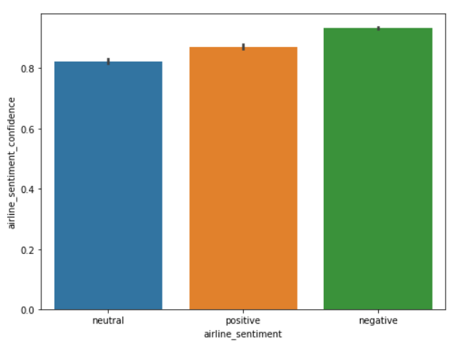
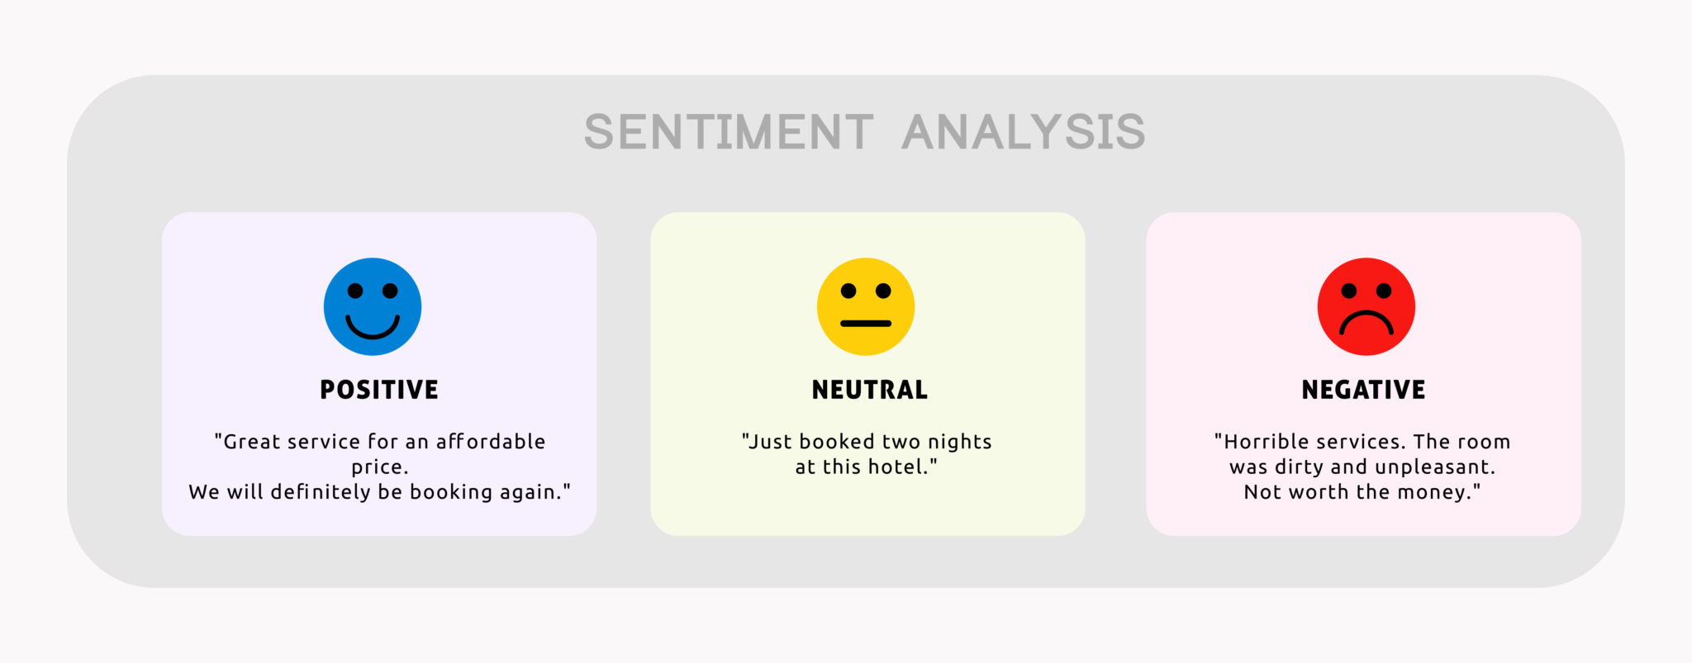
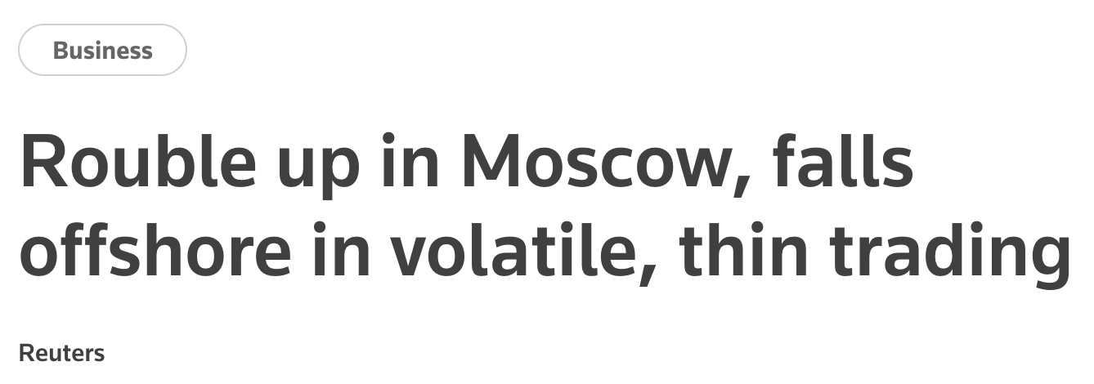

Sentiment Analysis
Quantify classification
Evaluate sentence sentiment
Sample sentence
I had a good day!
Tokenize
What about more complex sentences?
?
https://expressanalytics.com/blog/social-media-sentiment-analysis/

Slide 4

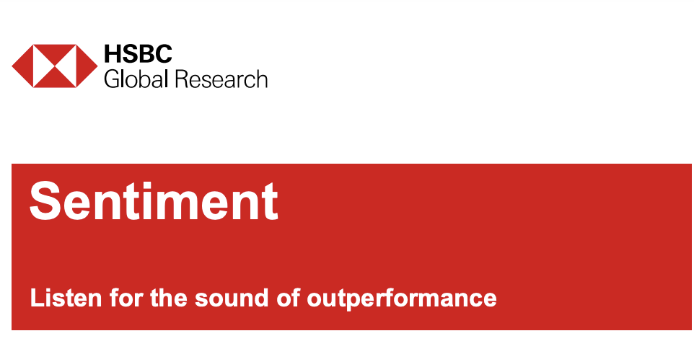
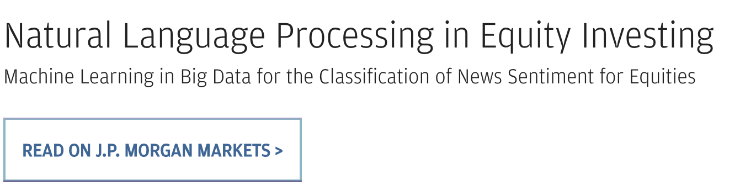
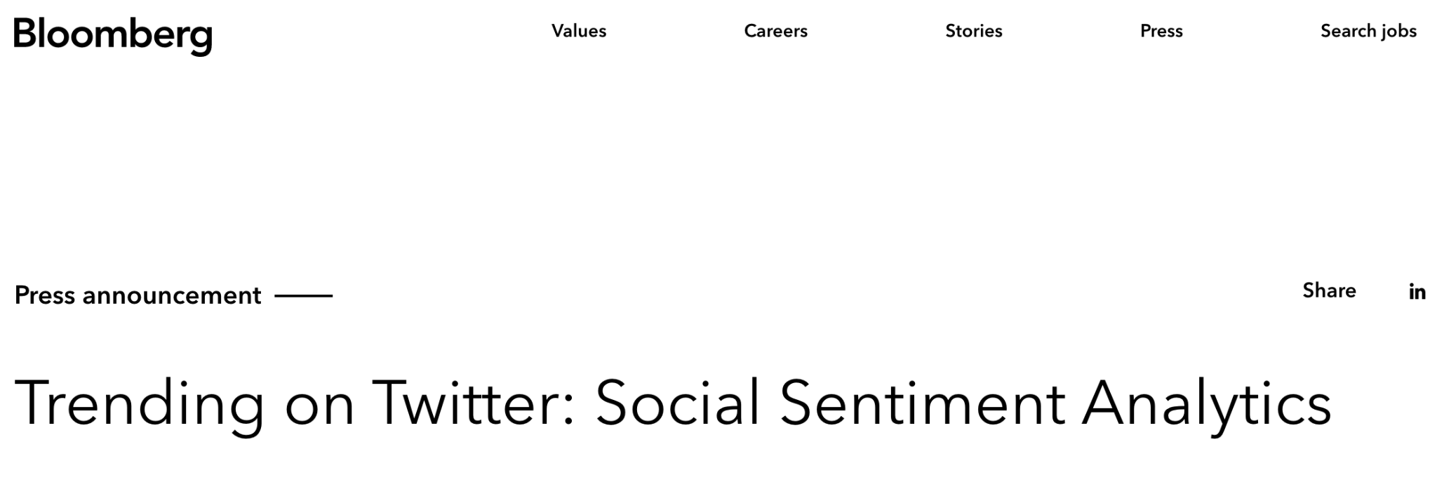
Sentiment Analysis in Industry

Slide 5




Sentiment Analysis Pipeline
Get stock headline
Sentiment analysis on headline
Give buy or sell recommendation
Collect data and find trend between words and prices
Gather information on price change since headline
https://expressanalytics.com/blog/social-media-sentiment-analysis/

Slide 6
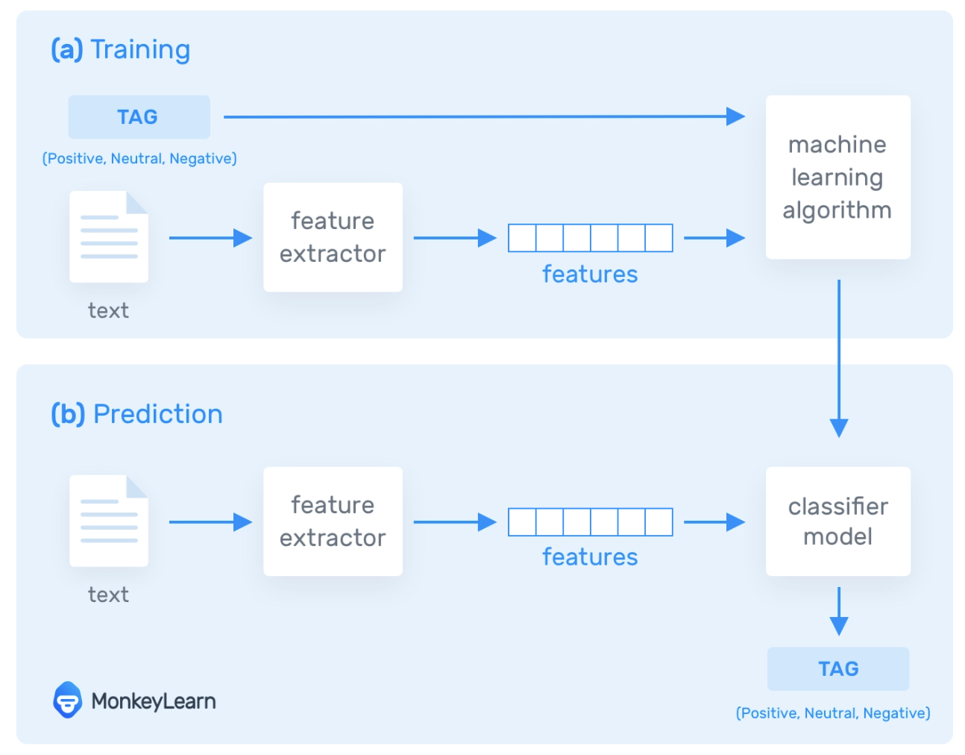
Details about the machine learning
Database consisting of thousands of lexicons and dictionaries
Dissects each sentence and extracts key features (Tokenizing)
https://monkeylearn.com/sentiment-analysis/

Slide 7
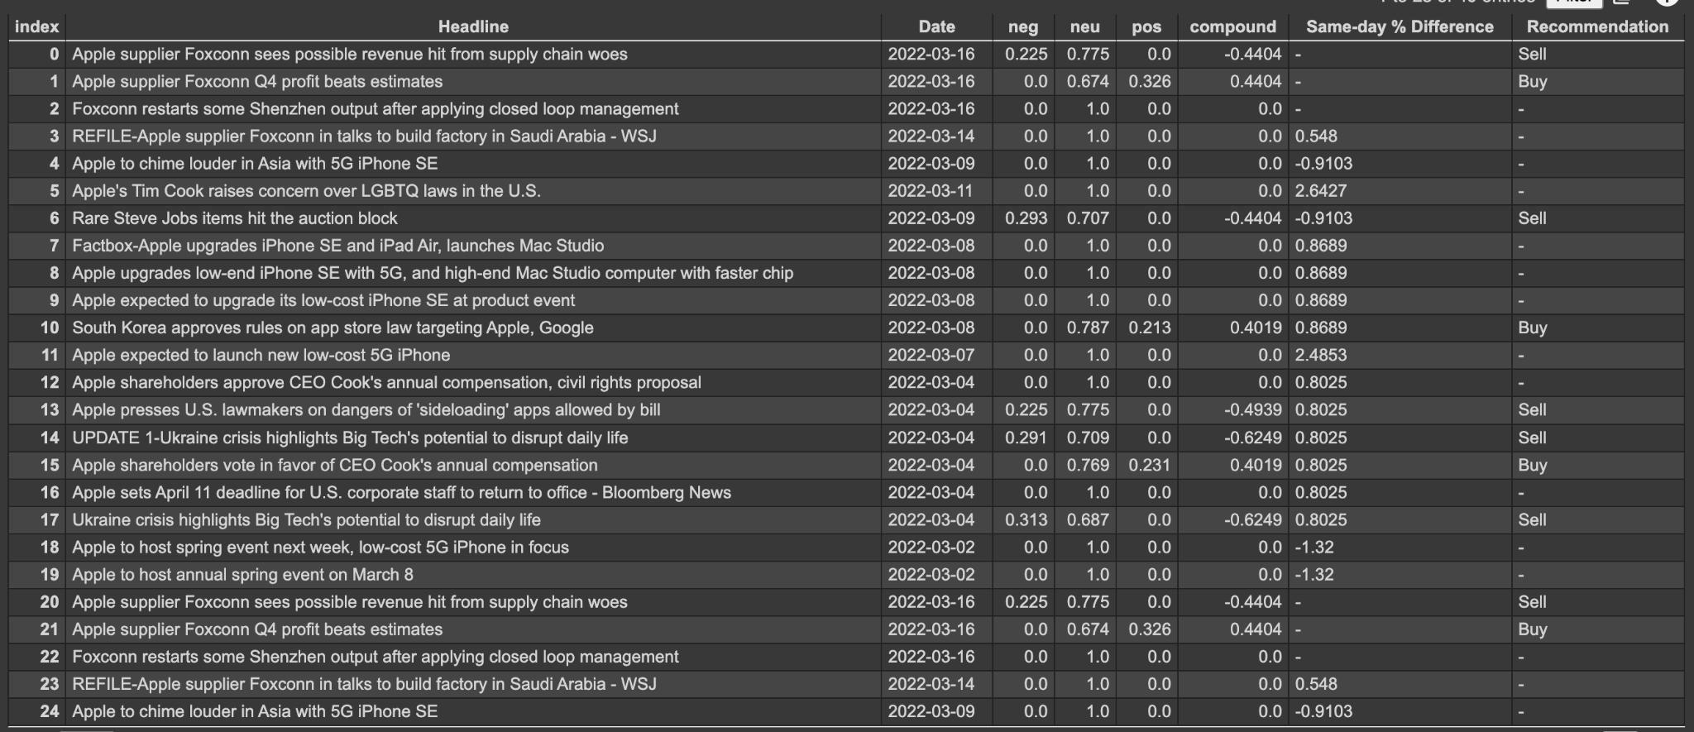
Sample Output
NLP
Data Analysis
Get Headline from websites
Compound
Recommendation

Slide 8
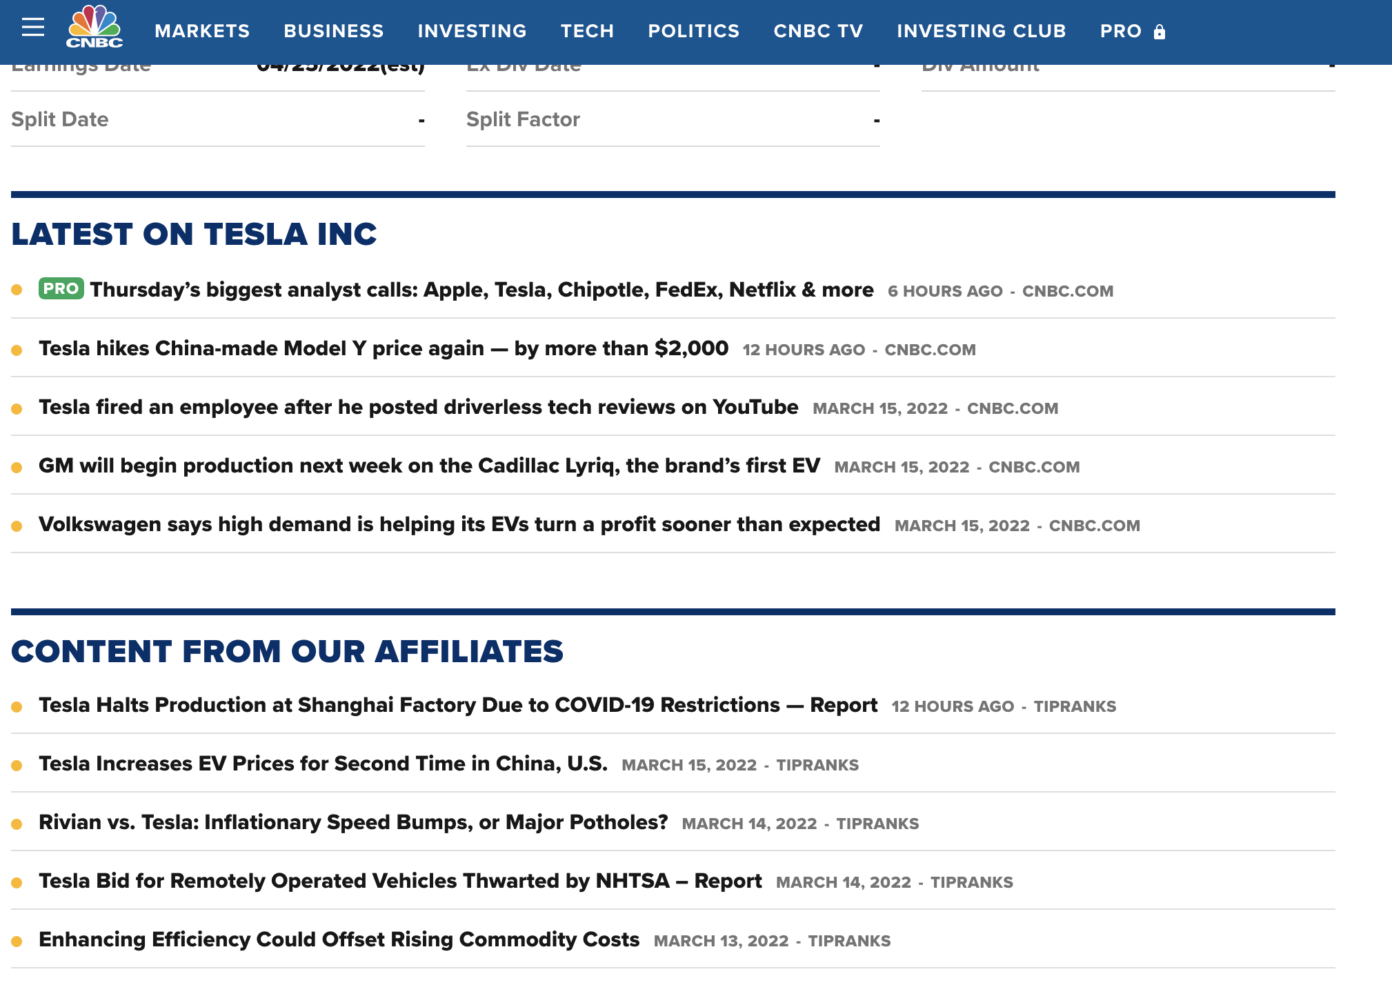
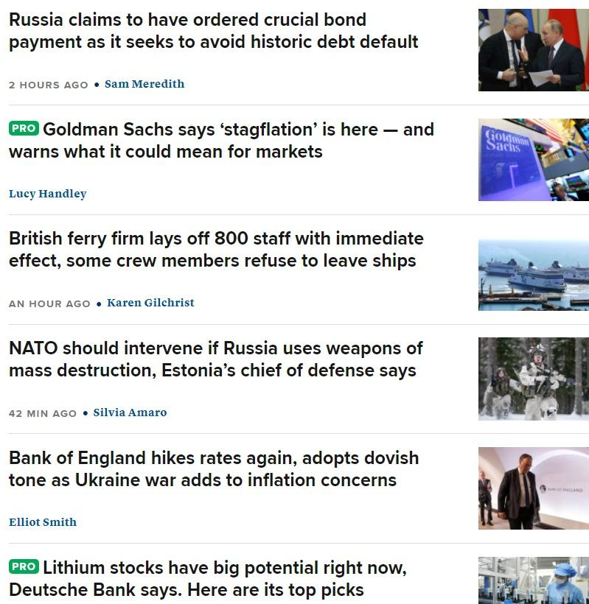
How we are scraping headlines from website?

Slide 9
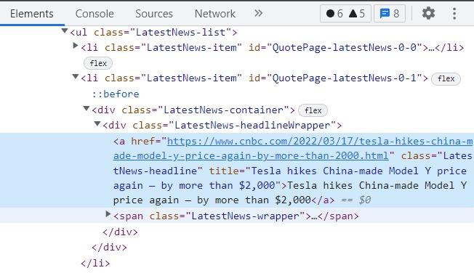
Scraping HTML web page headlines
https://www.cnbc.com/quotes/TSLA

Slide 10
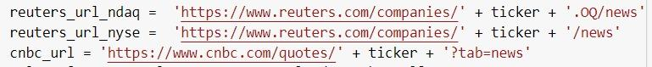
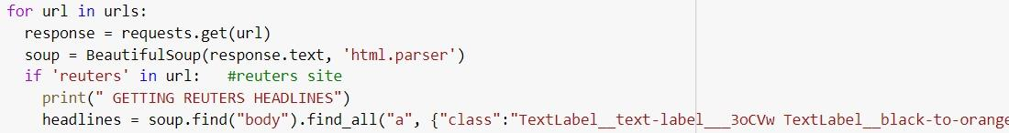
Python Web Scraping

Slide 11
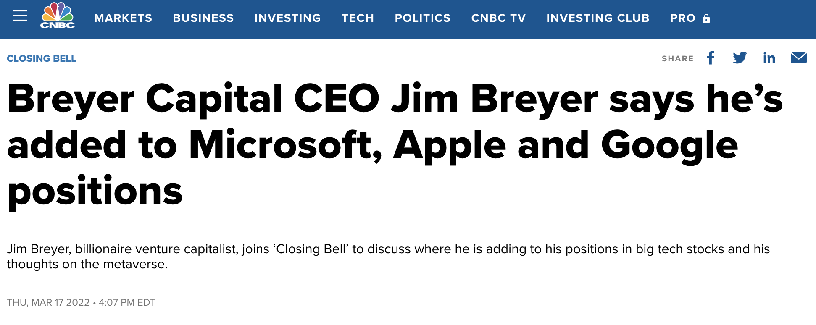
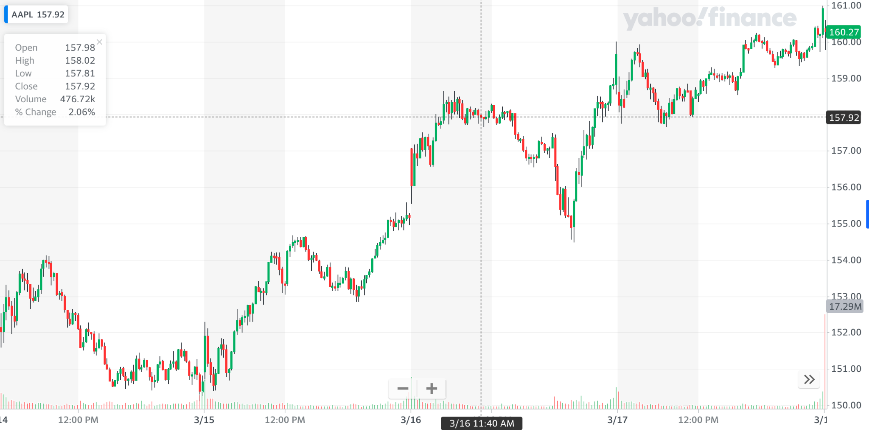
Price effects and correlations with headline sentiment
Extract datetime data
Pinpoint price at headline time
(oPrice - cPrice)/oPrice
Average over opening and closing price
Source: Yahoo Finance

Slide 12
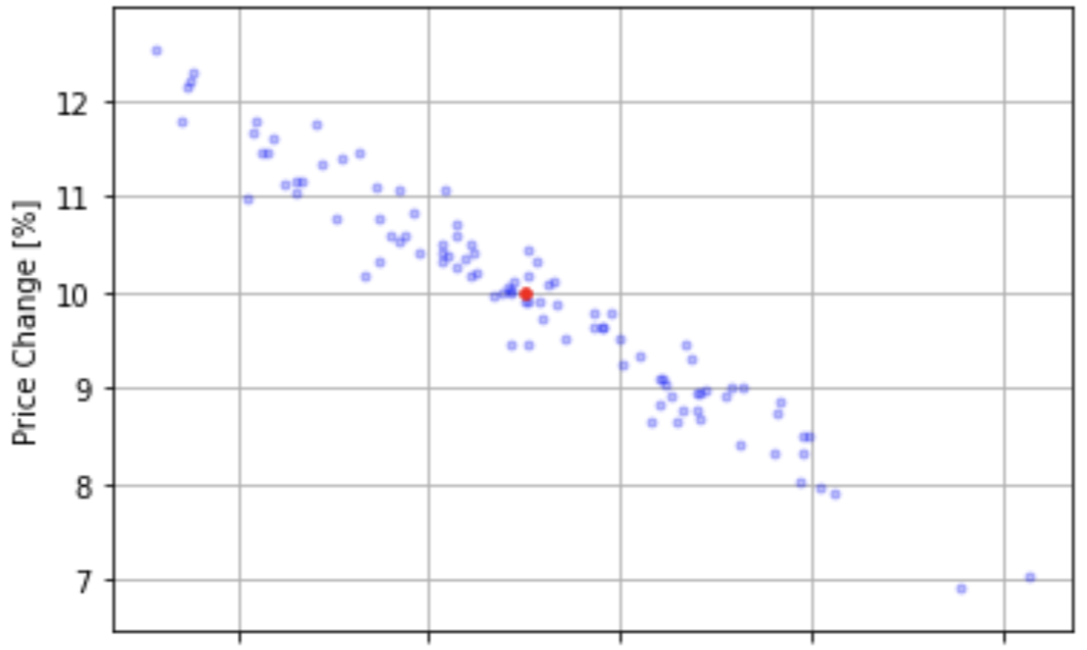
Finalizing an algorithmic trading strategy
Run model simulations
Collect correlation data between stock price and headline sentiment score
Give buy/sell recommendations based on correlation score
Create database of high impact words
“High”
“beat”
“peak”
“optimism”

Slide 13
Demo time!
https://colab.research.google.com/drive/14D90X8fiZqbS0WXulWri7gxUnyWdmJcF#scrollTo=VECurWKncHTZ&uniqifier=2

Slide 14
References
https://www.dreamstime.com/change-price-black-icon-change-price-black-icon-clipart-image-isolated-white-background-image159532153
https://www.mivision.com.au/2016/11/to-buy-or-not-to-buy-your-practice-premises2/
https://www.dynamicfieldwork.com/changing-times-international-data-collection/
https://stackabuse.com/python-for-nlp-sentiment-analysis-with-scikit-learn/

